Slide 1
Getting Started with GeoDa
Jack Tieszen
Geospatial Resources Librarian at Fenwick Library
jtieszen@gmu.edu

Slide 2
Purpose of this workshop.
Lightning introduction and discussion of GeoDA.
What it is?
Uses?
Hands on exercise to get you familiar with:
Interface.
Tools and features of the software.

Slide 3
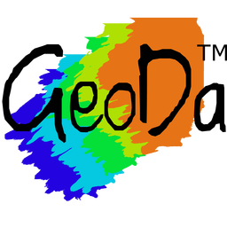
What is GeoDa?
GeoDa is a user-friendly software program that has been developed since 2003 to support the free and open-source spatial analysis research infrastructure.
It has one goal: To help researchers and analysts meet the data-to-value challenge. This challenge involves translating data into insights.
Explicit focus on spatial methods for spatial data.

Slide 4
Uses?
The program is specialized in exploratory data analysis and geo-visualization, where it exploits techniques for dynamic linking and brushing.
When the user has multiple views or windows in a project, selecting an object in one of them will highlight the same object in all other windows.
GeoDa also is capable of producing histograms, box plots, scatter plots to conduct simple exploratory analyses of the data.
GeoDa has the capability of mapping and linking those statistical devices with the spatial distribution of the phenomenon that the users are studying.

Slide 5
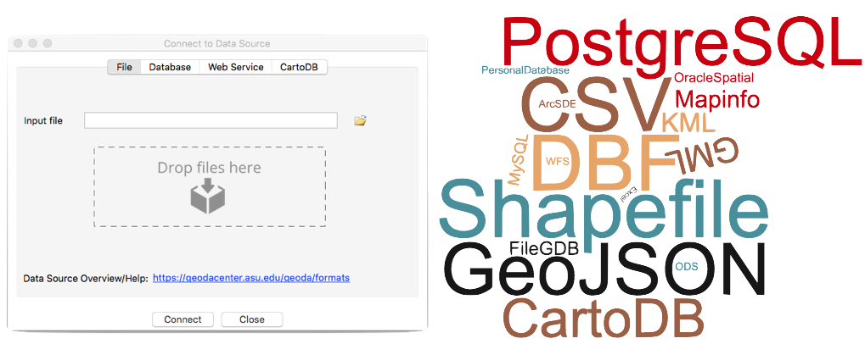
Some other features:
Supports many different data formats.
Multi-layer support for geospatial data.
Basemaps for visualizing data.
Comparing averages across time and space.
Analyze spatial and temporal patterns across linked views.
And many more.

Slide 6
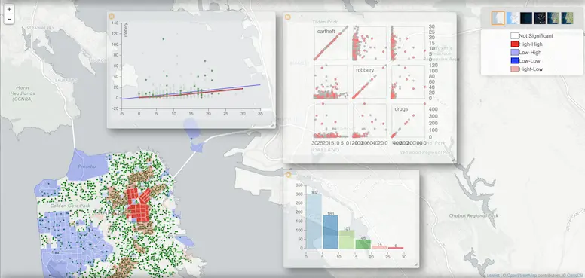
Difference from standard GIS?
GeoDa is an analytical tool with GIS capabilities, not a standalone GIS.
Doesn’t feature:
Cartographical operations (as robust as something like ArcMap of QGIS).
GIS program integration.
Manipulating geometry within system.

Slide 7
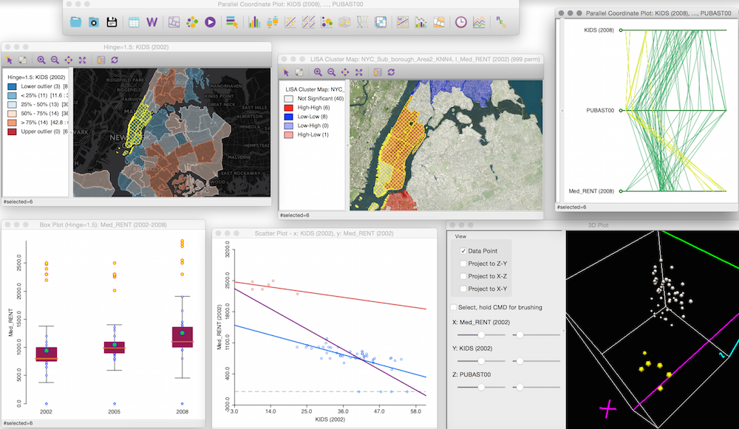
Workshop Exercise:
We will do some basic spatial data wrangling.
If you downloaded “GeoDA” workflow document you will also have access to the tutorial concerning the GIS operations.

